Slide 1
Wipro Warranty Claim Analytics Dashboard

Slide 2
Wipro Warranty Claim Analytics Dashboard identifies product failures, providing insights into the reasons behind these issues and repeated customer problems, enabling manufacturers to enhance product quality. The tool distinguishes genuine warranty claims from duplicates, offering clarity on claim patterns among dealers and retailers. It highlights potential fraud risks, allowing manufacturers to implement preventive measures. By recognizing specific dealers or retailers making the most claims, the dashboard aids in effective partnership management. It also assesses the risk of fraud for each claim, helping manufacturers mitigate their exposure to fraudulent warranty claims. Manufacturers can proactively address customer challenges by understanding recurring problems. This data-driven approach optimizes product design, improves customer satisfaction, and strengthens brand loyalty.

Slide 3
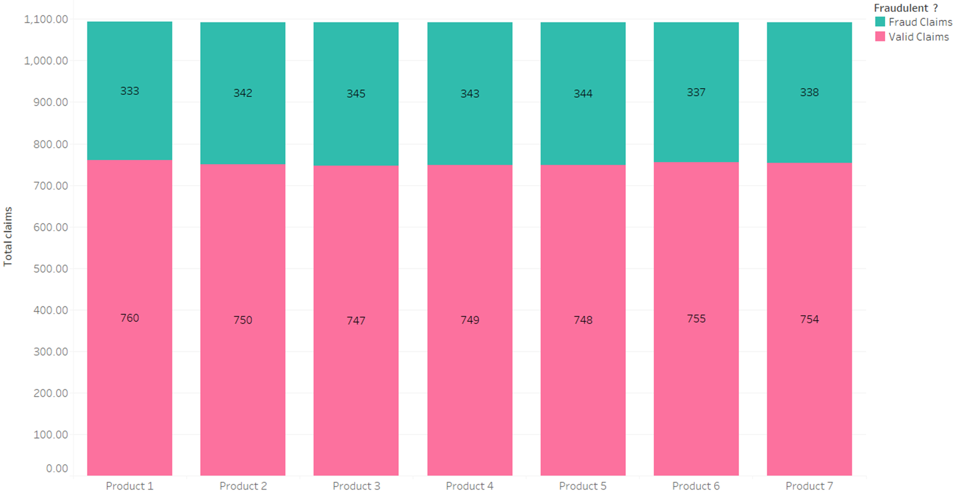
Almost 30 % of the warranty claims for each product are identified to be fraud claims
For every product, number of claims seems to be equal around 1090
The filters applied were State and Claim date where all the values are considered

Slide 4
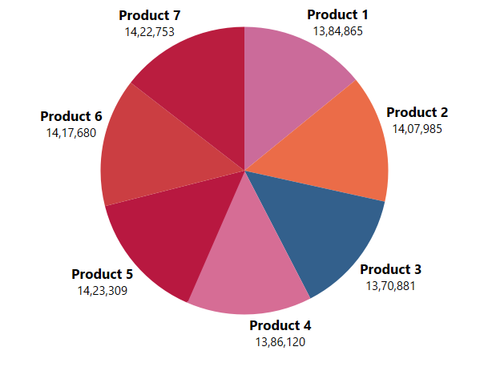
Product 5 with highest number of fraud claims has highest warranty claim cost
Product 5 has total of 1092 claims out of which 344 claims are classified to be fraud
This is the highest number when compared to fraud claims for the rest of products

Slide 5
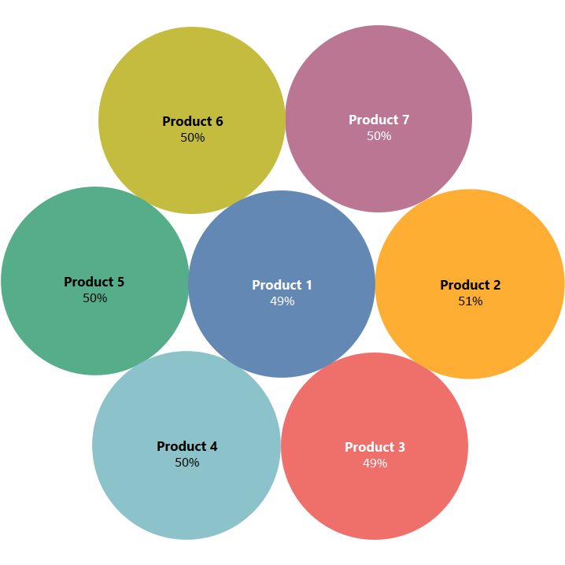
All the products have around 50% of fraud risk
Product 2 has risk of 51%
Product 1 & 3 has 49% fraud risk
The rest of the products have 50% fraud risk

Slide 6
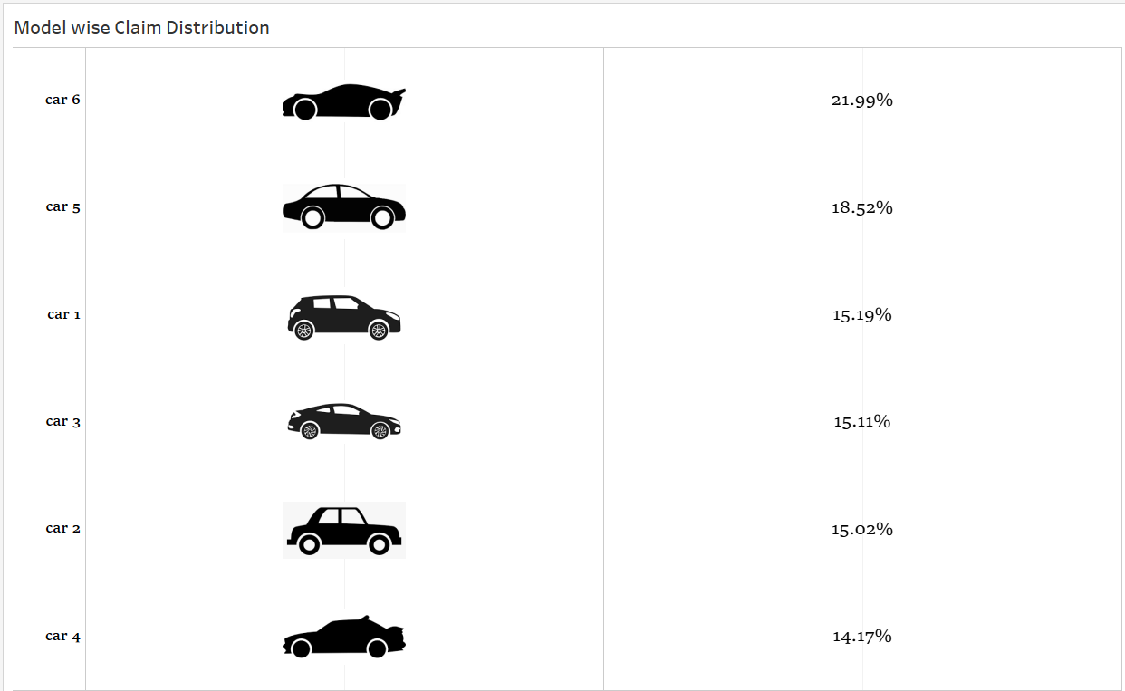
Model of Car 6 is more prone to fraud with high value of 22% fraud rate

Slide 7
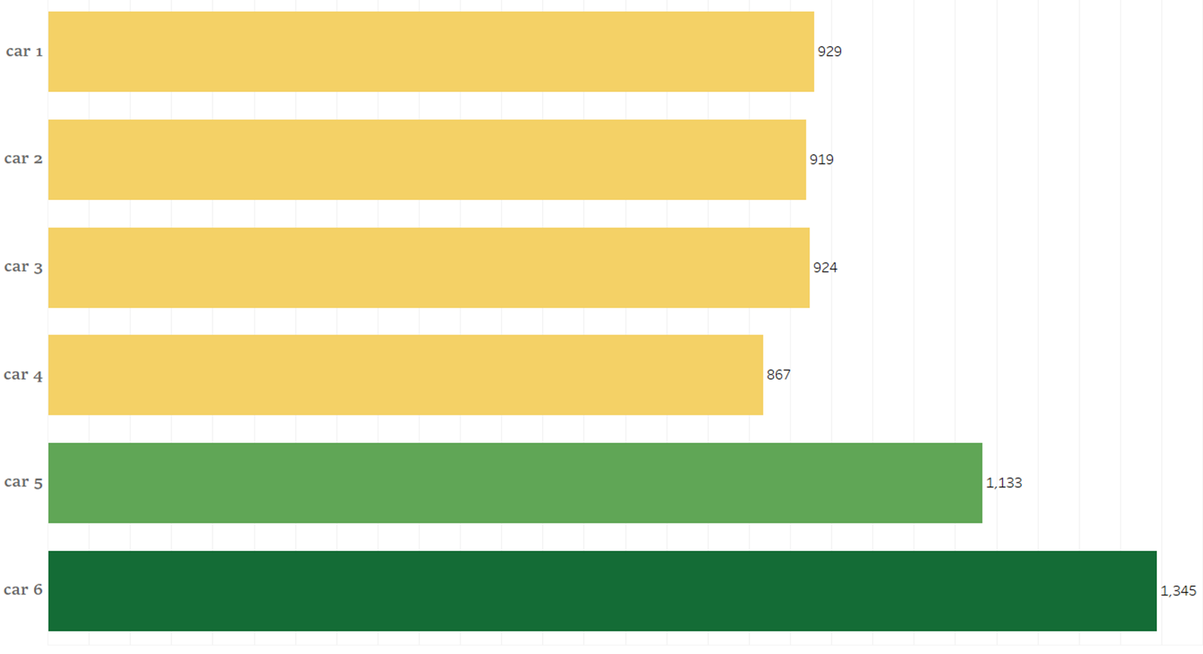
Car 6 that has highest fraud claim rate has higher warranty claims
Car 6 that has 22 % fraud rate has 1345 claims raised.
The second highest model Car 5 that has 19 % fraud rate also has higher claims of 1133 compared to other models
We can observe the number of claims being raised is inter related to fraud risk %

Slide 8
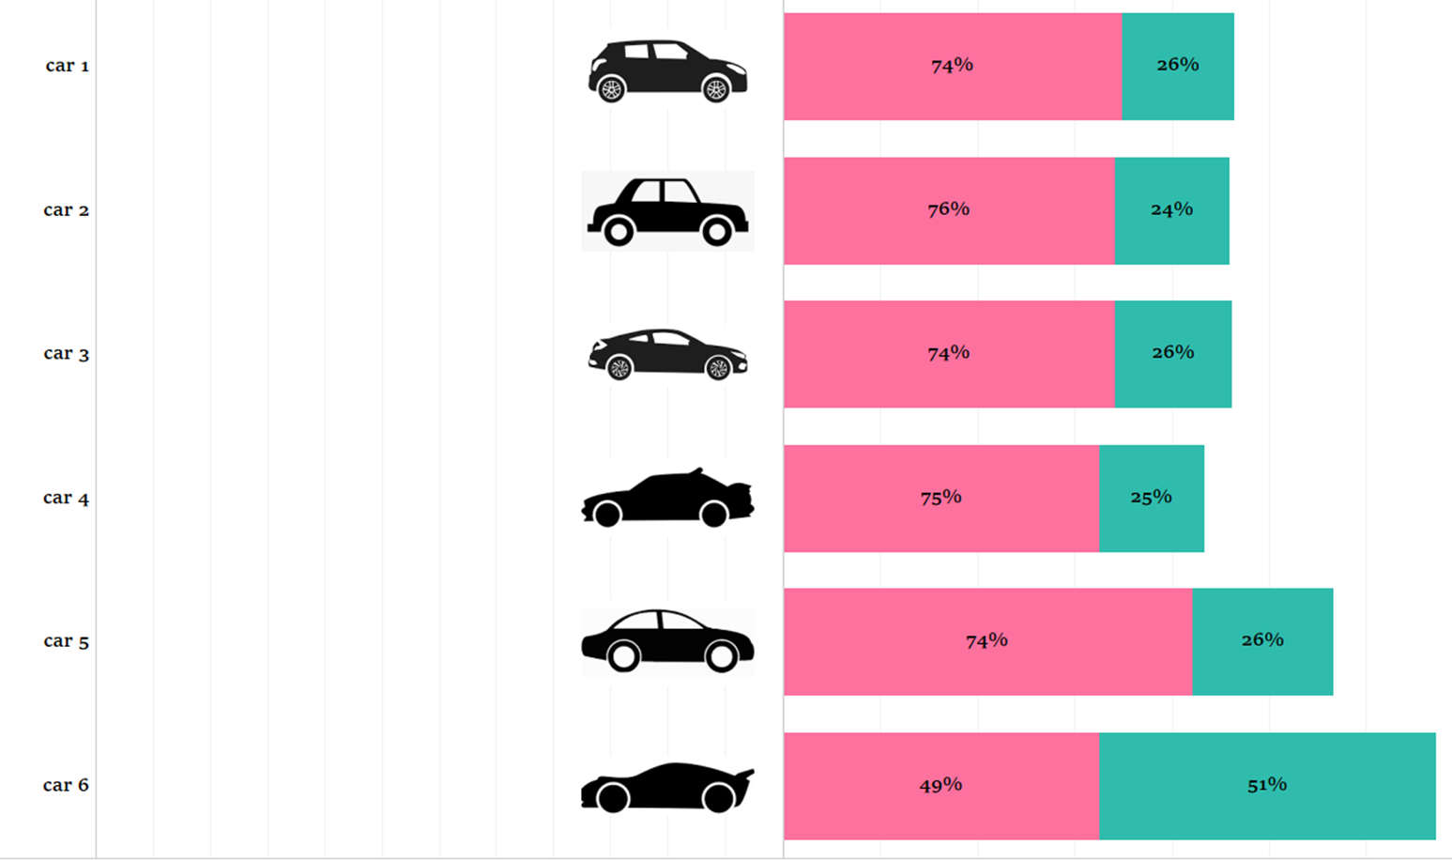
>50% of claims for Car 6 are observed to be fraud claims
Car 6 that has 22% fraud prone rate has highest percent of fraud claims
Car 5 even though being second in fraud prone rate, only 26 % of the claims are observed to be fraud claims
For all other models, the fraud claims are only around 25% which is considered to be moderate

Slide 9
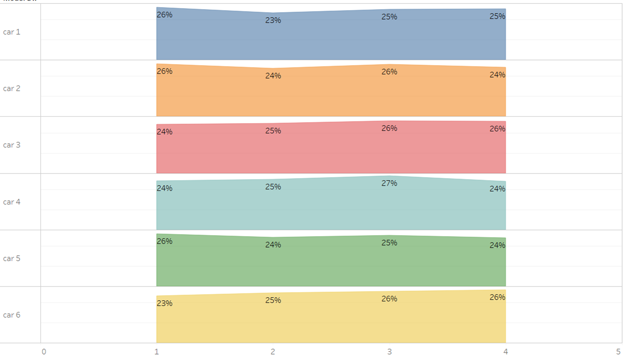
Warranty claims against each models seems to be consistent around 25% for each quarter
For every model of car for each quarter the percent of claims raised is around 25%
Only for Car 4, the claims percentage increased by 2% in Q3, which is negligible considering the fraud claim rate against the model
For Car 6 which is on discussion, the claim rate increased by 2% from Q1 to Q2 and 1% from Q2 to Q3 while remaining constant for Q4

Slide 10
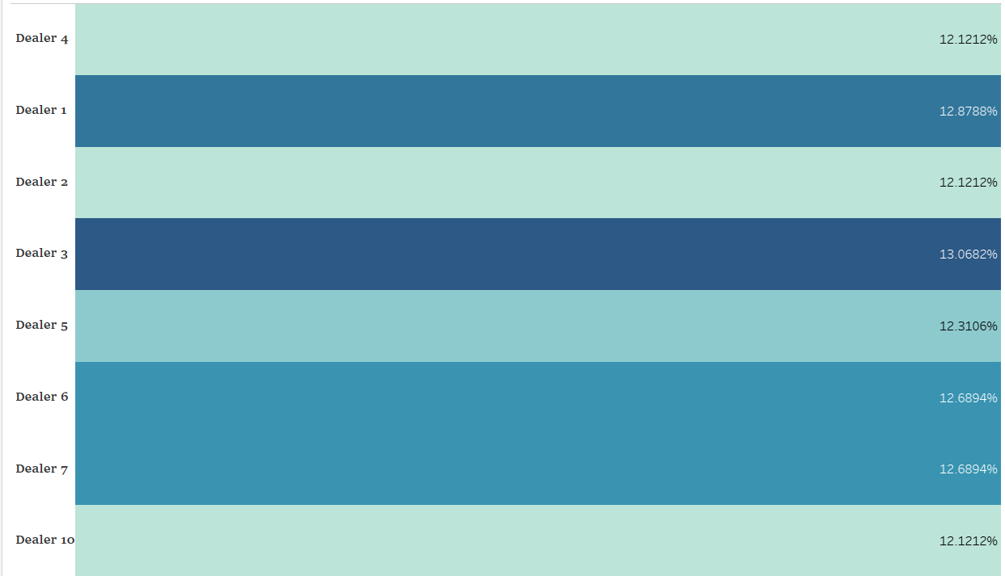
Around 13% of fraud claims are observed from Dealer 3
Dealer 1 stands next to Dealer 3 with 12.8%
Dealer 6 & 7 follows Dealer 1 with 12.7% each

Slide 11
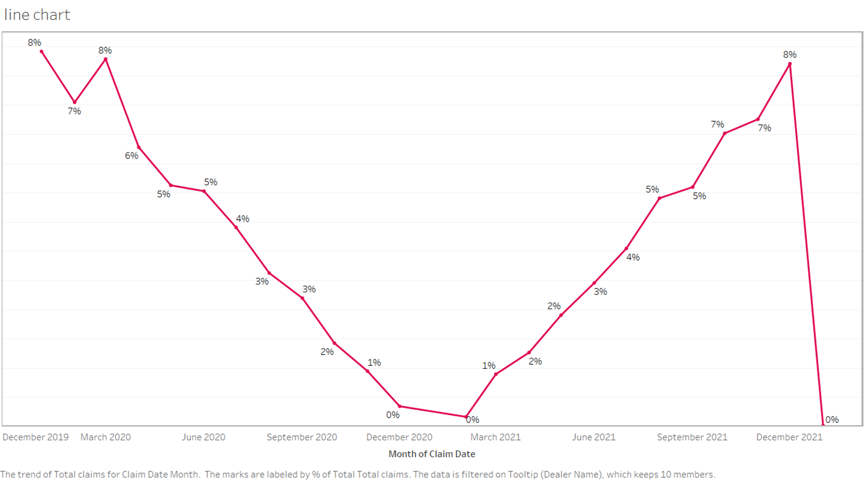
Monthly Claim percentage for each dealer follows a U-Shaped trend
The Claim percentage is evaluated monthly wise using the claim date
The percentage is around 8% ate the end of 2021 which decreased to 0% by the end of 2020
It is increased in the same trend as it decreased from 2021

Slide 12
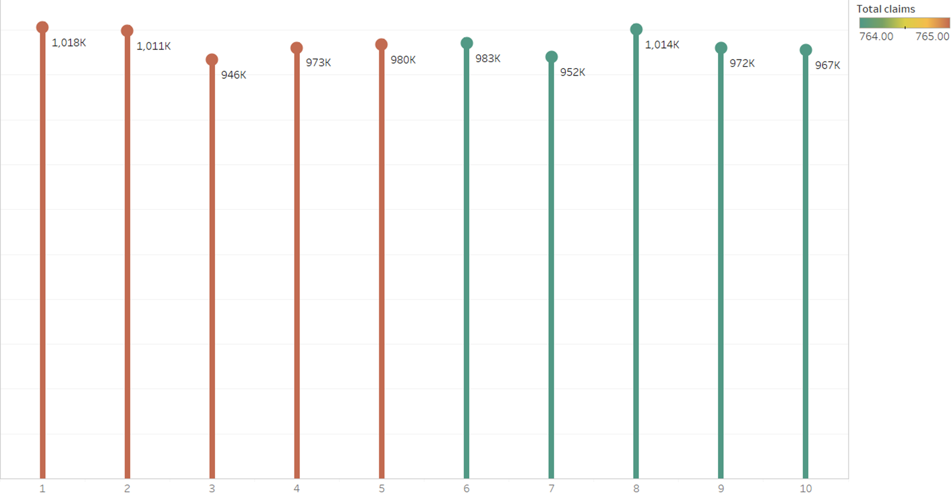
An average of $1000K of warranty claim cost can be seen from all the dealers
Dealer 1, 2 & 8 have highest claim cost of around $1010K
Rest of the dealers also have the claim cost around $950K

Slide 13
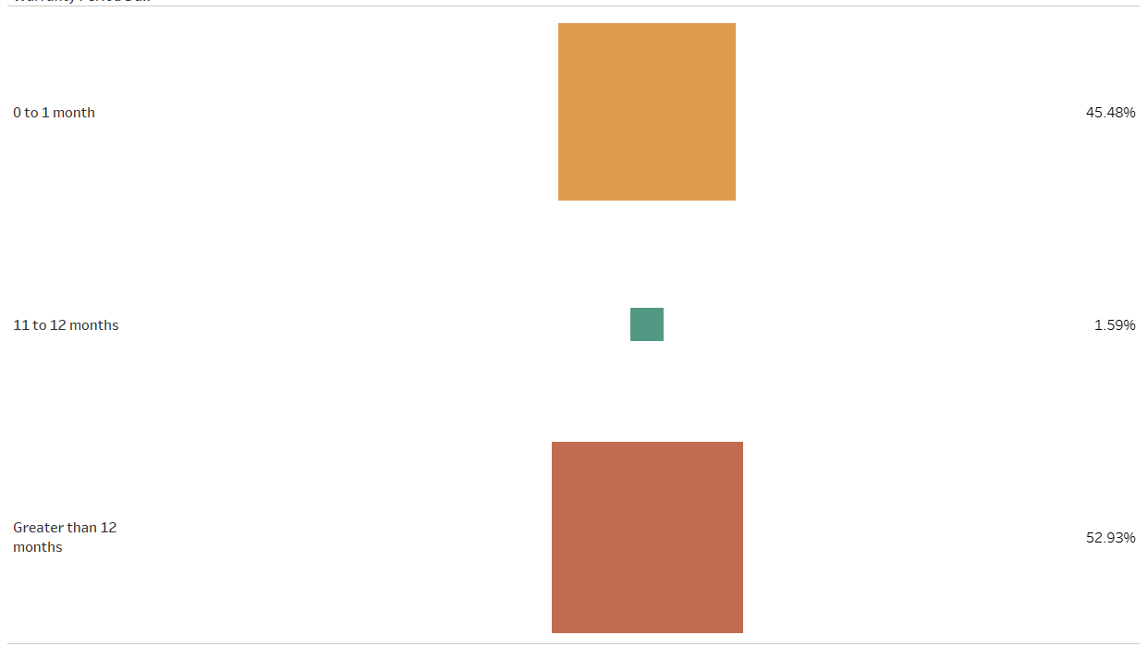
Around 45% claims are raised within one month of warranty
>52% of the total claims are raised after 12 months of warranty
Around 2% of claims are during 11 to 12 months of warranty

Slide 14
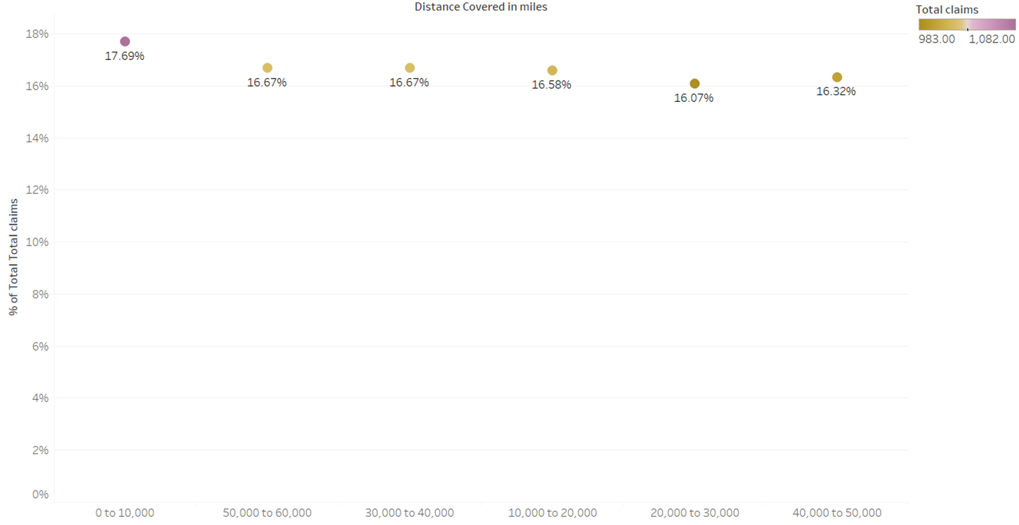
Almost 18% of claims are raised within 10k miles of distance

Slide 15
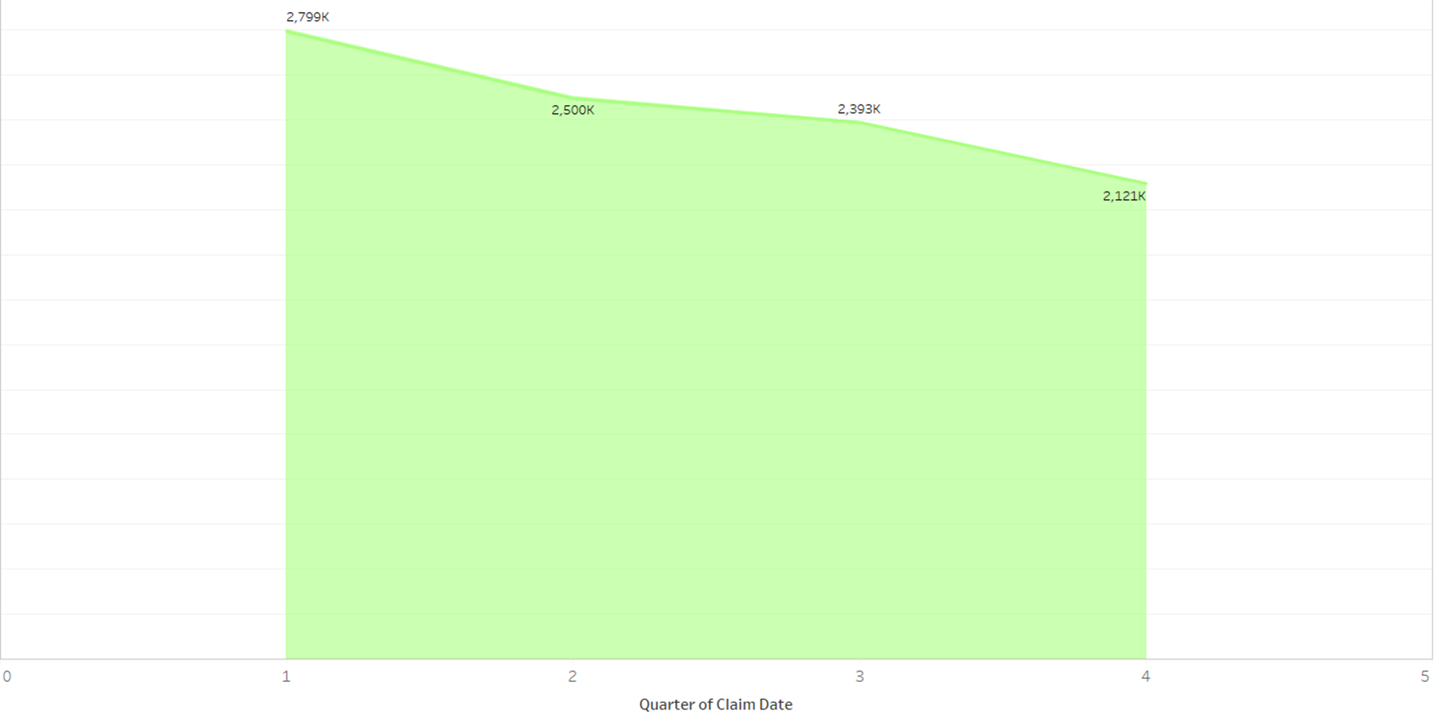
Decreasing trend of loss due to fraud claims across the Quarters

Slide 16
KEY TAKE AWAYS
Warranty Claim Cost Analysis:
Product 5 demands close monitoring due to its highest warranty claim cost.
Notably, this product also records the highest number of claims classified as fraud.
Model-Specific Focus:
Car 6 stands out with over 50% of fraud claims and the highest claim amounts.
Prioritize thorough evaluation of this model to address these issues effectively.
Dealer Impact:
Dealer 1's vehicles show a higher susceptibility to fraud, contributing significantly to overall warranty claim costs.
Investigate the operations and transactions associated with this dealer for potential fraudulent activities.

Slide 17
KEY TAKE AWAYS
Mileage and Claim Patterns:
A significant portion of claims correlates with vehicles covering less than 10,000 miles.
Explore the connection between lower mileage and monthly claim spikes, emphasizing the need for closer scrutiny in these cases.
Fraud Loss Management:
Although fraud-related losses are declining, further improvements can be achieved.
Implement targeted strategies based on the identified trends to reduce fraud losses effectively.

Slide 18
THANK YOU

